Slide 1
Part 2 Basics of C++

Slide 2
Introduction
Computer program
Sequence of statements whose objective is to accomplish a task
Programming
Process of planning and creating a program
Real-world analogy: a recipe for cooking

Slide 3
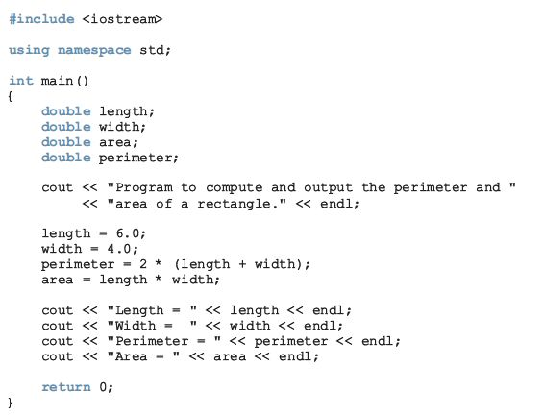
A C++ Program

Slide 4
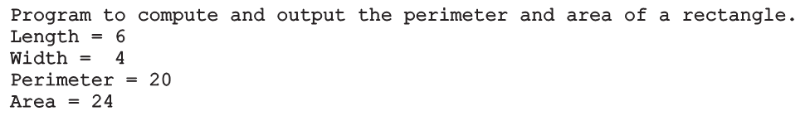
A C++ Program (cont’d.)
Sample run:

Slide 5
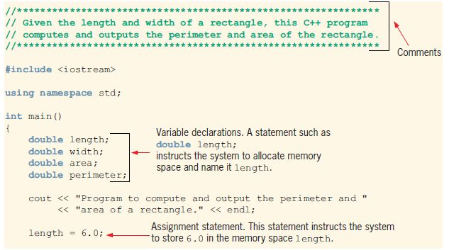
A C++ Program (cont’d.)

Slide 6
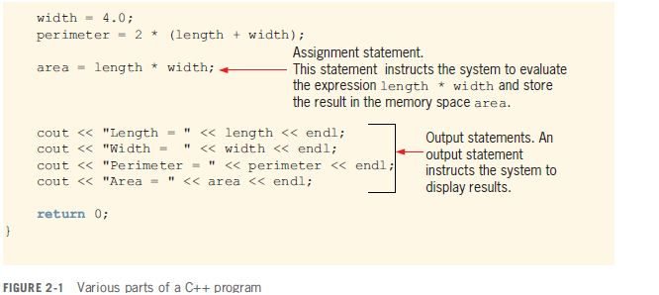
A C++ Program (cont’d.)

Slide 7

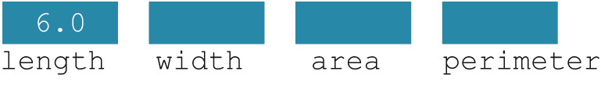
A C++ Program (cont’d.)
Variable: a memory location whose contents can be changed
Figure 2-2 Memory allocation
Figure 2-3 Memory spaces after the statement length = 6.0; executes

Slide 8
Arithmetic
Arithmetic calculations
Use * for multiplication and / for division
Integer division truncates remainder
7 / 5 evaluates to 1
Modulus operator returns the remainder
7 % 5 evaluates to 2
Operator precedence
Some arithmetic operators act before others (i.e., multiplication before addition)
Be sure to use parenthesis when needed
Example: Find the average of three variables a, b and c
Do not use: a + b + c / 3
Use: (a + b + c ) / 3

Slide 9
Arithmetic
Arithmetic operators:
Rules of operator precedence:

Slide 10
Order of Precedence
All operations inside of () are evaluated first
*, /, and % are at the same level of precedence and are evaluated next
+ and – have the same level of precedence and are evaluated last
When operators are on the same level
Performed from left to right (associativity)
3 * 7 - 6 + 2 * 5 / 4 + 6 means
(((3 * 7) – 6) + ((2 * 5) / 4 )) + 6

Slide 11
Equality and Relational Operators

Slide 12
Logical Operators
Truth Table |  | Meaning | Operator in C++
OUTPUT | INPUT Exp1 Exp2
F F F T | F F F T T F T T | Logical AND | &&
F T T T | F F F T T F T T | Logical OR | ||
T F | F T | Logical NOT | !

Slide 13
Operators Precedence update

Slide 14
The Basics of a C++ Program
Function (or subprogram): collection of statements; when executed, accomplishes something
May be predefined or standard
Syntax rules: rules that specify which statements (instructions) are legal or valid
Semantic rules: determine the meaning of the instructions
Programming language: a set of rules, symbols, and special words

Slide 15

Special Symbols
Token: the smallest individual unit of a program written in any language
C++ tokens include special symbols, word symbols, and identifiers
Special symbols in C++ include:

Slide 16
Reserved Words (Keywords)
Reserved word symbols (or keywords):
Cannot be redefined within program
Cannot be used for anything other than their intended use
Examples:
int
float
double
char
const
void
return

Slide 17
Identifiers
Identifier: the name of something that appears in a program
Consists of letters, digits, and the underscore character (_)
Must begin with a letter or underscore
C++ is case sensitive
NUMBER is not the same as number
Two predefined identifiers are cout and cin
Unlike reserved words, predefined identifiers may be redefined, but it is not a good idea

Slide 18
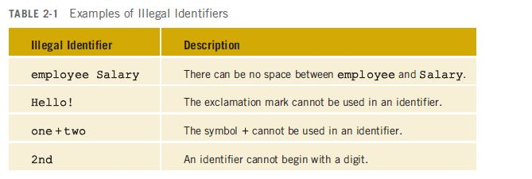
Identifiers (cont'd.)
Legal identifiers in C++:
first
conversion
payRate

Slide 19
Whitespaces
Every C++ program contains whitespaces
Include blanks, tabs, and newline characters
Used to separate special symbols, reserved words, and identifiers
Proper utilization of whitespaces is important
Can be used to make the program more readable

Slide 20
Memory Concepts
Variable names
Correspond to locations in the computer's memory
Every variable has a name, a type, a size and a value
Whenever a new value is placed into a variable, it replaces the previous value - it is destroyed
Reading variables from memory does not change them
A visual representation
integer1
45

Slide 21
Variable Names (Identifiers)
Letter + {Letters and/or Digits and/or ( _ )
_ +Letter+{Letters and/or Digits and/or ( _ )
Naming Convention(Style)
Variables➔ LengthInYard , hours
Functions➔ CalcAverage , Cube(27)
Constant➔ MAX_HOUR , LIMIT
Underscore character ( _ )
Correction | Explanation ? | Invalid
forty_Hours , hours40 | Begin with a digit | 40Hours
get_Date , getDate | Blanks not allowed | Get Date
box_22 , box22 | The hyphen(-) is minus | Box-22
costInUSDollar | Special symbols not allowed | cost_in_$
int_1 | Reserved word in C++ | int

Slide 22
Data Types
short int :Range of values ( ±32,767 ).
long int :Range of values ( ±2,147,483,647 ).
int : Integer numbers
float: floating point used for working with real numbers.
double: is a floating point type much like float , but it can store a value of much greater magnitude with greater precision.
Bool: is a boolean data type can take two value TRUE or FALSE.
char: character data type (alpha,digit,special-symbol or space).
A single character with its value quoted with single-quotation
egs. ‘A’ , ‘a’ , ‘$’ , ‘ ‘ , ‘8’
string: for working with multiple characters including letters, numbers , special symbols and spaces its value quoted with double- quotation. egs. “C++” , “Computer Science” , “ “.
Letter
S.Symbol
Space
Digit

Slide 23
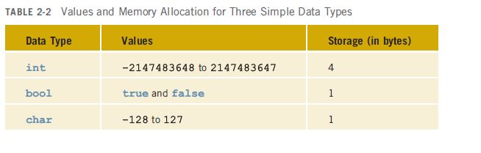
Simple Data Types (cont’d.)
Different compilers may allow different ranges of values

Slide 24
int Data Type
Examples:
-6728
0
78
+763
Cannot use a comma within an integer
Commas are only used for separating items in a list

Slide 25
bool Data Type
bool type
Two values: true and false
Manipulate logical (Boolean) expressions
true and false
Logical values
bool, true, and false
Reserved words

Slide 26
char Data Type
The smallest integral data type
Used for single characters: letters, digits, and special symbols
Each character is enclosed in single quotes
'A', 'a', '0', '*', '+', '$', '&'
A blank space is a character
Written ' ', with a space left between the single quotes

Slide 27
char Data Type (cont’d.)
Different character data sets exist
ASCII: American Standard Code for Information Interchange
Each of 128 values in ASCII code set represents a different character
Characters have a predefined ordering based on the ASCII numeric value
Collating sequence: ordering of characters based on the character set code

Slide 28
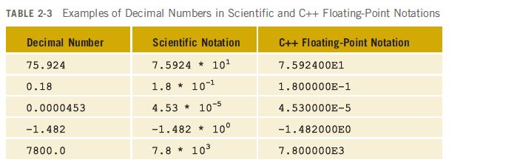
Floating-Point Data Types
C++ uses scientific notation to represent real numbers (floating-point notation)

Slide 29
Floating-Point Data Types (cont’d.)
float: represents any real number
Range: -3.4E+38 to 3.4E+38 (four bytes)
double: represents any real number
Range: -1.7E+308 to 1.7E+308 (eight bytes)
Minimum and maximum values of data types are system dependent

Slide 30
Floating-Point Data Types (cont’d.)
Maximum number of significant digits (decimal places) for float values: 6 or 7
Maximum number of significant digits for double: 15
Precision: maximum number of significant digits
Float values are called single precision
Double values are called double precision

Slide 31
Data Types and Variables
To declare a variable, must specify the data type it will store
Syntax: dataType identifier;
Examples:
int counter;
double interestRate;
char grade;

Slide 32
Type Conversion (Casting)
Implicit type coercion: when value of one type is automatically changed to another type
Cast operator: provides explicit type conversion
static_cast<dataTypeName>(expression)

Slide 33
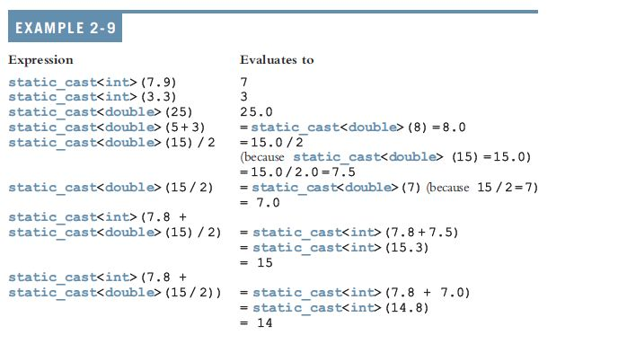
Type Conversion (cont’d.)

Slide 34
string Type
Programmer-defined type supplied in ANSI/ISO Standard C++ library
Sequence of zero or more characters enclosed in double quotation marks
Null (or empty): a string with no characters
Each character has a relative position in the string
Position of first character is 0
Length of a string is number of characters in it
Example: length of "William Jacob" is 13

Slide 35
Declaration of Variables
Constant Variables
Data Type Identifier1, Identifier2,…;
const Data Type Identifier=value;
Examples and preference:
Examples:
char Letter, middleInt , ch;
const string STARS=“*****”;
const char ch=‘$‘;
const float MAX_Hour=40.0
char Letter;
char middleInt;
char ch;

Slide 36
Variables, Assignment Statements, and Input Statements
Data must be loaded into main memory before it can be manipulated
Storing data in memory is a two-step process:
Instruct computer to allocate memory
Include statements to put data into memory

Slide 37

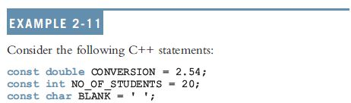
Allocating Memory with Constants and Variables
Named constant: memory location whose content can’t change during execution
Syntax to declare a named constant:
In C++, const is a reserved word

Slide 38

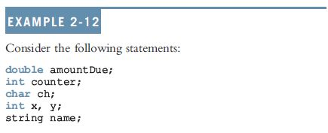
Allocating Memory with Constants and Variables (cont’d.)
Variable: memory location whose content may change during execution
Syntax to declare a named constant:

Slide 39
Putting Data into Variables
Ways to place data into a variable:
Use C++’s assignment statement
Use input (read) statements

Slide 40

Assignment Statement
The assignment statement takes the form:
Expression is evaluated and its value is assigned to the variable on the left side
A variable is said to be initialized the first time a value is placed into it
In C++, = is called the assignment operator

Slide 41
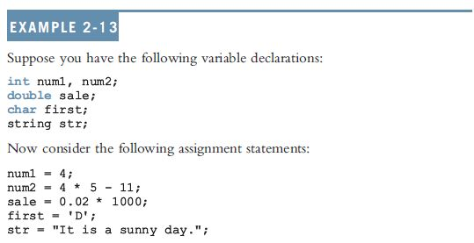
Assignment Statement (cont’d.)

Slide 42
Saving and Using the Value of an Expression
To save the value of an expression:
Declare a variable of the appropriate data type
Assign the value of the expression to the variable that was declared
Use the assignment statement
Wherever the value of the expression is needed, use the variable holding the value

Slide 43
Declaring & Initializing Variables
Not all types of variables are initialized automatically
Variables can be initialized when declared:
int first=13, second=10;
char ch=' ';
double x=12.6;
All variables must be initialized before they are used
But not necessarily during declaration

Slide 44
Assignment Statement
Variable = Expression ;
Store the value of the Expression into the variable, any previous value of the variable is destroyed.
Example: Giving the declarations
string firstname;
char letter;
int num;
➔Remark :Double or more assignment allowed and precedence from Right-to-Left
eg. N1=n2=n3=5;
firstname=“Sara”;
num = 5;
num=5*5-3;
letter=‘S’
Valid Assignment
firstname=Sara;
firstname=;
letter=S
Invalid Assignment

Slide 45
Comments
Comments are for the reader, not the compiler
Two types:
Single line: begin with //
// This is a C++ program.
// Welcome to C++ Programming.
Multiple line: enclosed between /* and */
/*
You can include comments that can
occupy several lines.
*/

Slide 46
Comments
/* …………..Text……..
……………. Text ……… */
For Multiple Lines
// ………… Text …………
For Single Line
The compiler ignores comments (Not executable)
C++ Preprocessor
➔ #include<iostream> :- This line known as Preprocessor Directive its not handled by C++ compiler but by a program known as Preprocessor.
➔ iostream :- Header file contains declarations of I/O facilities.
➔ Preprocessor program acts as a filter before compilation.
Source program
Preprocessor
Expanded Source
program
C++ Compiler

Slide 47
Operators Precedence update

Slide 48
Summary
C++ program: collection of functions, one of which is always called main
Identifiers consist of letters, digits, and underscores, and begins with letter or underscore
The arithmetic operators in C++ are addition (+), subtraction (-), multiplication (*), division (/), and modulus (%)
Arithmetic expressions are evaluated using the precedence associativity rules

Slide 49
Summary (cont’d.)
All operands in an integral expression are integers
All operands in a floating-point expression are decimal numbers
Mixed expression: contains both integers and decimal numbers
Use the cast operator to explicitly convert values from one data type to another
A named constant is initialized when declared
All variables must be declared before used

